Slide 1
Argumentation for Collaboration Among Internet of Things
Henry Hexmoor, PhD
SIU, Carbondale, IL 62901

Slide 2
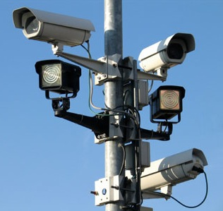
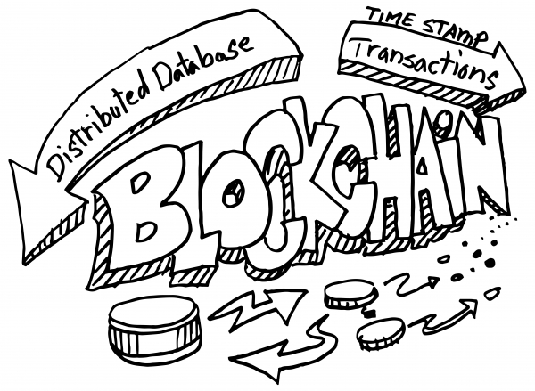
The Inexorable March of Automation…
Dreaded Robocall agents...
Robocop agents…Eyes in the sky…
Factory automation agents (robots and digital factories)
Intelligent transportation agents (infrastructures and driverless cars)
Automated trading agents (aka algorithmic trading and e-banking)
Automated trading and tariff agents in energy and ecommerce
Domestic automation agents (home automation systems)
Medical automation agents
Agriculture/farming automation agents
Automated legal resolution
…all require reasoning over complex networks…
Collaboration is imperative…

Slide 3
The need for Appropriate automation input…
Smart (e.g., driverless)
Appropriate control /good decision
Overly cautious (e.g., driver assist)
Low automation
Inappropriate control/bad decision…

Slide 4
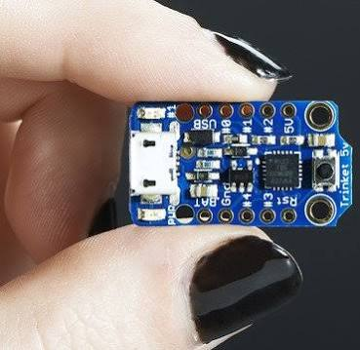
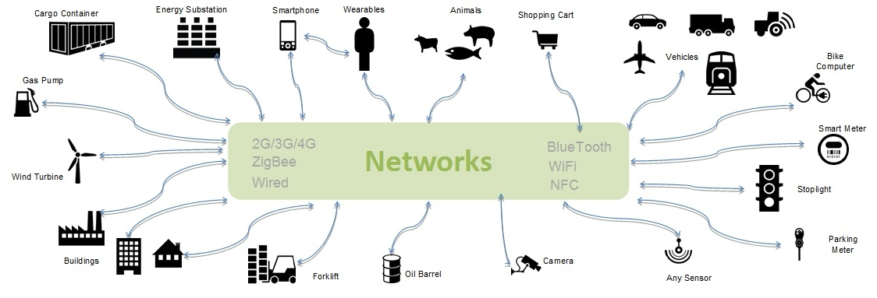
Emergence of Cyber Physical Systems…

Slide 5
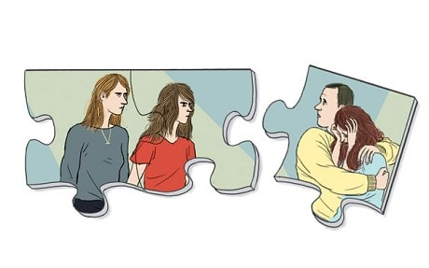
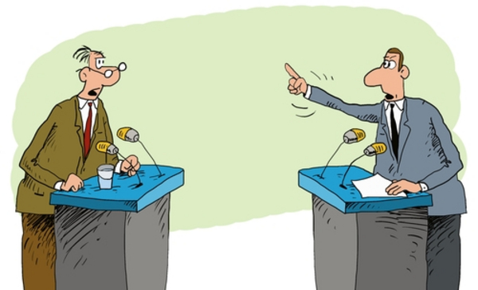
Collaboration is…
Task and role assignment or self-adoption
Coordination and Cooperation
Haggling: negotiation that leads to reasoning…
Argumentation
Collaborative groups are organizations…

Slide 6
Collaborative Organizations…
Traditional (people only)
Online (People plus agents)
E.g., Bla Bla Car… Social Trust
Virtual (agents only)

Slide 7
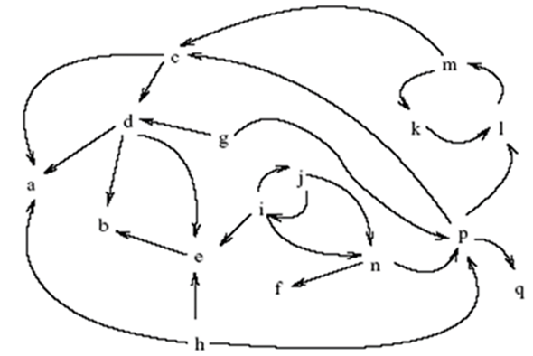
Arguments…
Sensory data
(Toulmin grounds/facts)
Justification
(Toulmin Warrant)
Recommended Action/position
(Toulmin
Claim/Conclusion)

Slide 8
Argumentation in context…
Physical
&
Cognitive
Fusion
Agent
Reasoning &
Problem Solving
Social sensors
Embedded processor devices
&
Social notifications
The environment &
the Occupants
People and IoT devices

Slide 9
Argument Generation and Conflict
An agent generates a set of competing arguments with results of applying expert system inference with respect to an objective.
A pair of arguments a1 and a2 with respect to an objective O, regardless of the agents who generated them, are in conflict iff the difference between the degree to which a1 and a2 satisfy objective O is significantly large.
For example, consider a predator animal and two prey animals. The objective for prey is not be caught by the predator. If the suggested direction of escape by the prey are very different, then their argument for escape direction would be in conflict.

Slide 10
Objectives and Collaboration
Objectives are anchors for collaboration among agents.
Each objective creates a subspace of competitive arguments. We represent these using Voronoi diagrams.

Slide 11
Conclusions
Automation and agent based automated environments are inevitable.
Cyber Physical systems are here to stay.
Collaboration is imperative.
Argumentation is an enabling technology
A case study…

Slide 12
An active shooter…1

Slide 13
An active shooter…2

Slide 14
An active shooter…3

Slide 15
An active shooter…4

