Slide 1
CS 499 Midterm Presentation
March 20, 2008
Team DunKyan
Notes:
Mike

Slide 2
Brief Overview
Functionality implemented to date
Current activities
Plans for rest of semester
Software demonstration
  Reporting Application
  I.S. Management Application
Notes:
Mike

Slide 3
Functionality Implemented to Date
Login page
Reporting Application (partially complete)
  Site connections
  Querying
  Subscribing
  Result viewing
I.S. Management Application (complete)
  User Manager
  Profile Manager
  Site Manager
  Reporting Application
Notes:
Mike

Slide 4
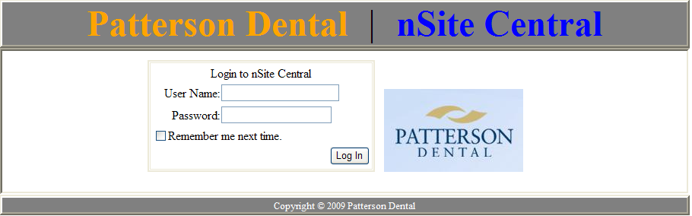
Login Page
Created superuser
Setup permissions for regular users
Check active status of user
Notes:
Ryan

Slide 5
Reporting App – Site Connections
Select a group of sites
Select multiple, individual sites
Hover tooltip displays description of groups and IP addresses of sites
Notes:
Kyle

Slide 6
Reporting App – Querying
Create a query
Save a query
Execute a query
Modify a query
Query ownerships
Query sharing
Field validation
Notes:
Ryan

Slide 7
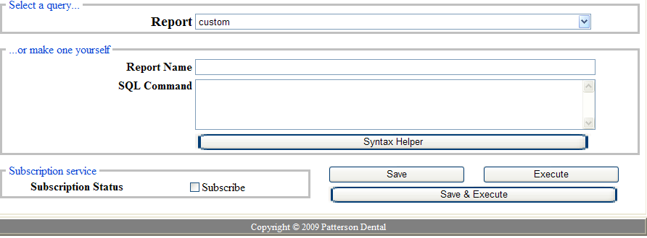
Reporting App – Subscribing
GUI for subscribing is set up, but functionality is not yet implemented
Notes:
Kyle

Slide 8
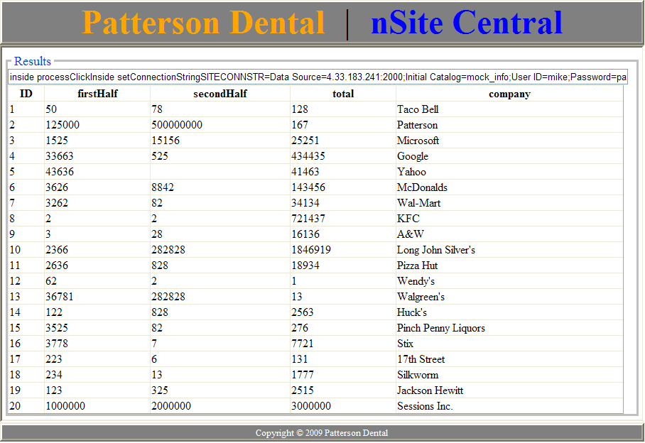
Reporting App – Result Viewing
Currently displays results in a gridview
Notes:
Mike

Slide 9
I.S. App – User Manager
Create user
Modify user
  Personal information
  Permissions
  Active status
Delete user
Notes:
Kyle

Slide 10
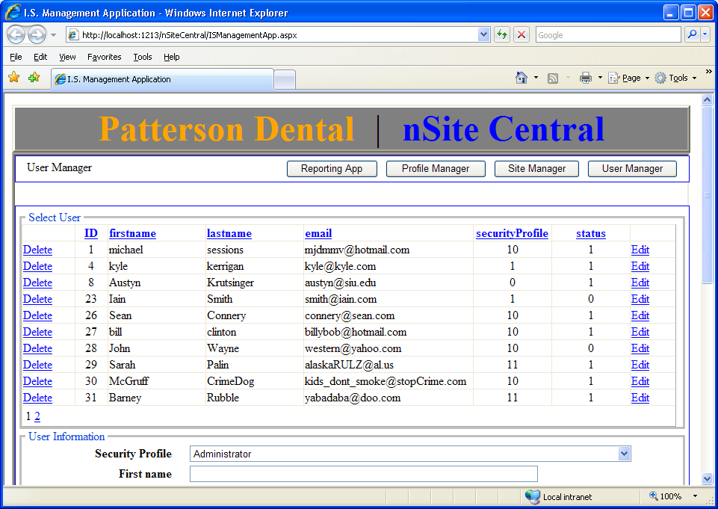

Slide 11
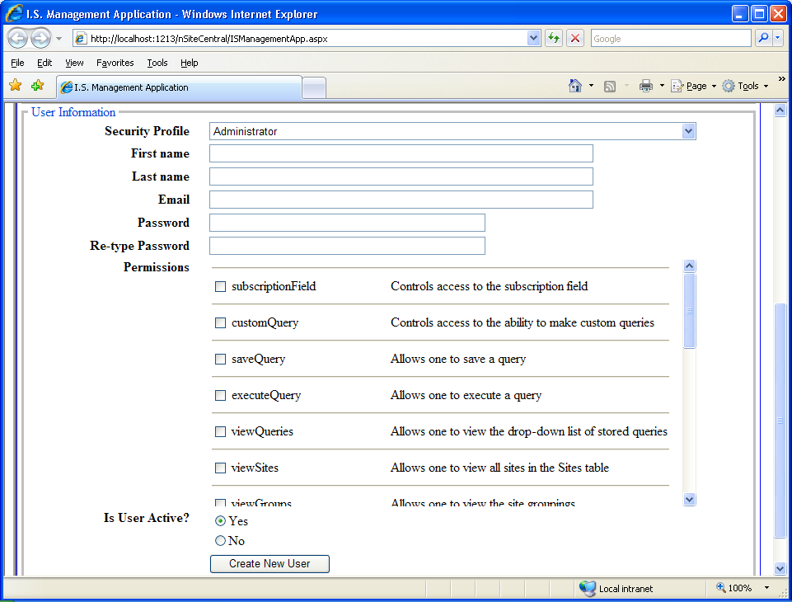

Slide 12
I.S. App – Profile Manager
Create profile
Modify profile
Delete profile
Notes:
Kyle

Slide 13
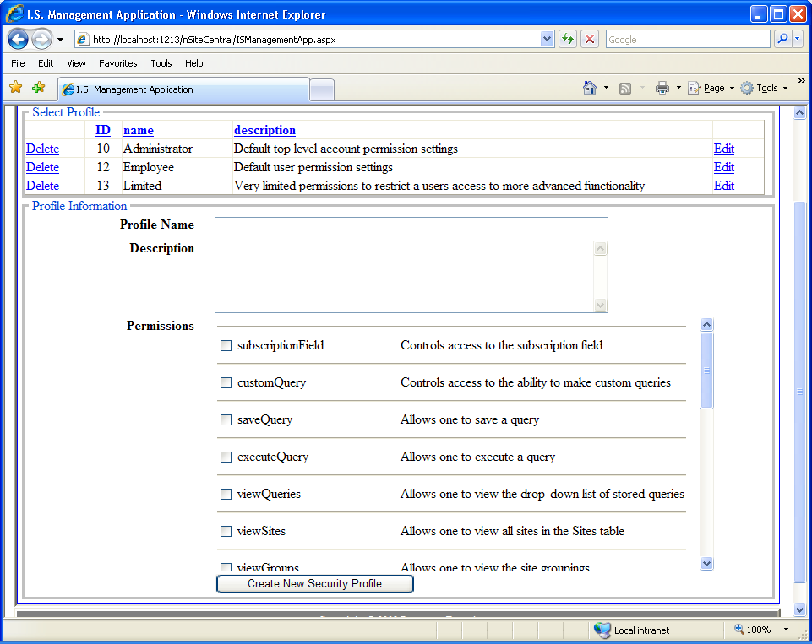

Slide 14
I.S. App – Site Manager
Create site
Modify site
  Group affiliation
  Connection parameters
Delete site
Notes:
Ryan

Slide 15
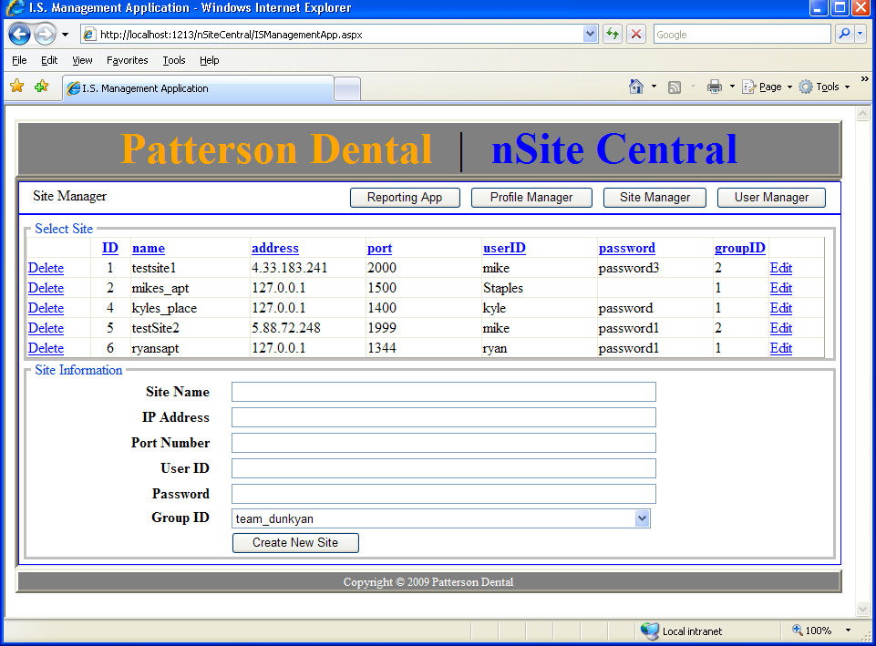

Slide 16
I.S. App – Reporting Application
Will be copied to I.S. App upon completion
Notes:
Mike

Slide 17
Current Activities
Working on implementing the ability to query remote databases
  This has been problematic so far
Working on formatting the results of queries using Crystal Reports
Notes:
Ryan

Slide 18
Plans for Rest of Semester
Finish Reporting Application
  Finish implementing the ability to query a remote database
  Finish reporting formatting with Crystal Reports
  Fully implement query subscriptions
  Compile complete list of security items
  Link sites to their corresponding groups
  Insert a description field in the security database for the Site table to use as the new Site tooltip
  When query is loaded, update the subscription checkbox accordingly
Notes:
Kyle

Slide 19
Plans for Rest of Semester (cont.)
Login page
  Add sessions to nSite Central
  Add superuser permissions (all)
Write user manual for nSite Central
Thoroughly test nSite Central
Give final presentation
Notes:
Kyle

Slide 20
nSite Central Demonstration
Notes:
Mike

