Slide 1
Project Design Document:
DSS Database Suite
Iain Smith & Austyn Krutsinger
December 11, 2008

Slide 2
Overview
Environment
Interface
UML Diagrams
Model Descriptions

Slide 3
Environment
Hardware:
  Client: Employee’s Workstation
  Server: Department Server
Operating System:
  Client: Windows XP/Vista with .NET Framework and MySQL extension
  Server: Windows Server 2000/2003/2008 with .NET Framework and MySQL database

Slide 4
Environment
Network Connection: Local Area Network currently setup in DSS building
Code Standard
  Database: MySQL
  Client: C# using Microsoft Visual Studio 2005
  Database Communication: Taken care of within the Client program
Performance: The system should save and load the records in the appropriate table of the DSS Database 100% of the time

Slide 5
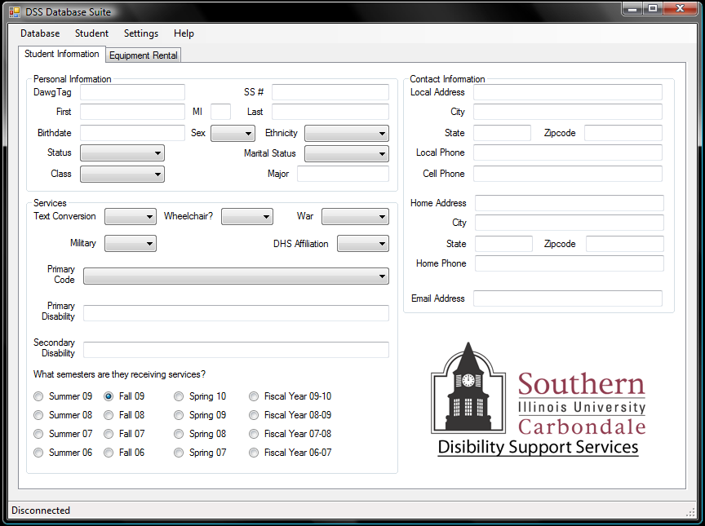
Interface: Basic

Slide 6
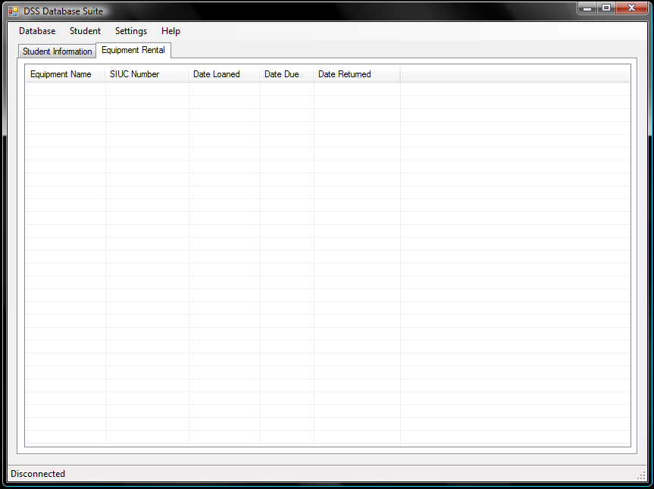
Interface: Equipment

Slide 7
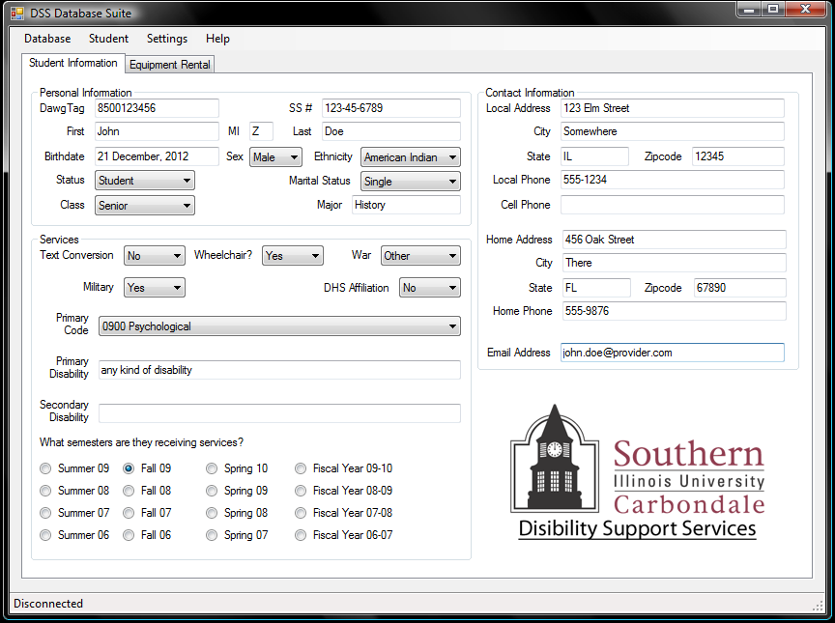
Interface filled in

Slide 8
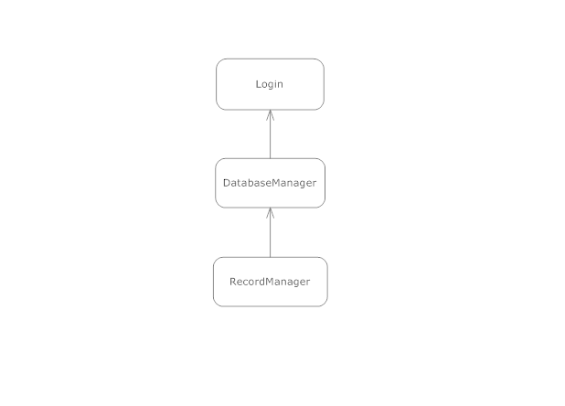
UML: Class Hierarchy

Slide 9
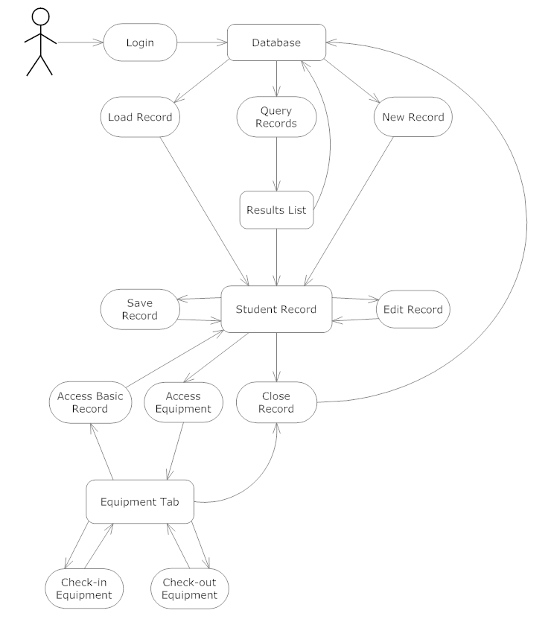
UML: Function Diagram

Slide 10
Model Description: Login
Login
The Login class is responsible for user access to the Database of Student Records. Employees can read, print and query records. Administrators can create and save records, as well as perform Employee tasks.
accountType username password
validate() – authenticate user’s login launchDatabase() – loads database and prepares for reading/writing

Slide 11
Model Descriptions: DatabaseManager
DatabaseManager
The DatabaseManager class is reponsible for managing the database of student records.
database[] studentRecord[] queries[]
loadRecord() – loads a student’s record from the database queryRecords() – search the database based on user defined search critera newRecord() – creates a new student record

Slide 12
Model Description: RecordManager
RecordManager
The RecordManager class is responsible for managing a student record.
basicRecord[] equipmentRecord[]
accessBasicRecord() – read student’s data from database editRecord() – edit the student’s database entry saveRecord() – save the data to the student’s database entry accessEquipment() – view equipment the student has checked out equipmentCheckin() – save check in information about equipment rental equipmentCheckout() – save check out information about equipment rental closeRecord() – close a currently opened record

Slide 13
Questions

