Slide 1
Final Project Presentation
Austyn Krutsinger & Iain Smith

Slide 2
Program Overview
Who is this for?
What does it do?
Key points
  Remove the need for paper records
  Save all information related to each student in a centralized database with a standardized architecture
  Ease-of-use

Slide 3
Becoming More Efficient
120 data fields down to 40
  18 MB database to 2 MB: 88% decrease in size
Intuitive interface
Localization of data
  Storing student information in one place instead of many
Electronic filing instead of paper work

Slide 4
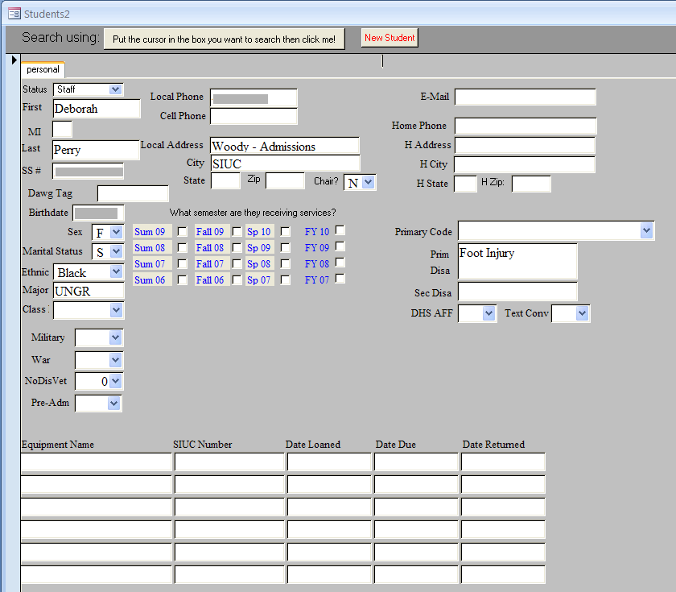
The Old System

Slide 5
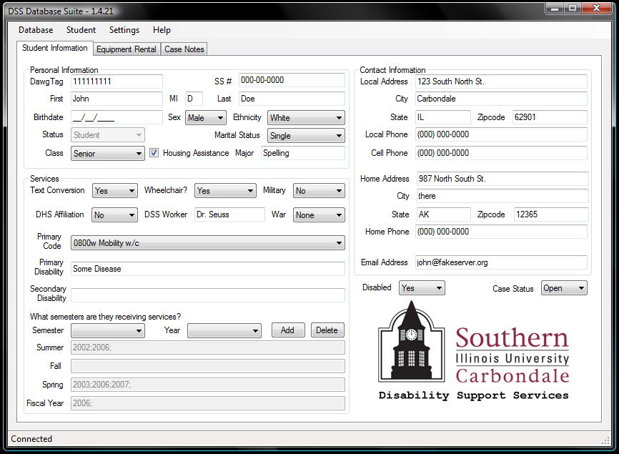
The New System

Slide 6
Program Information
Uses MySQL database to store records
Client will run on any windows platform with the MySQL C# library installed
Connection established over a LAN with NO communication outside LAN

Slide 7
Functionality

Slide 8
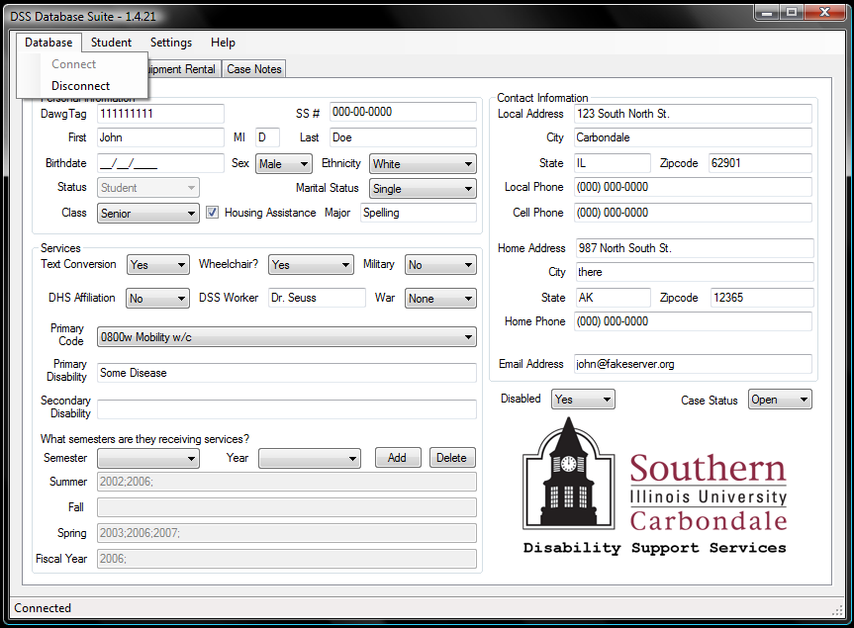
Connect/Disconnect

Slide 9
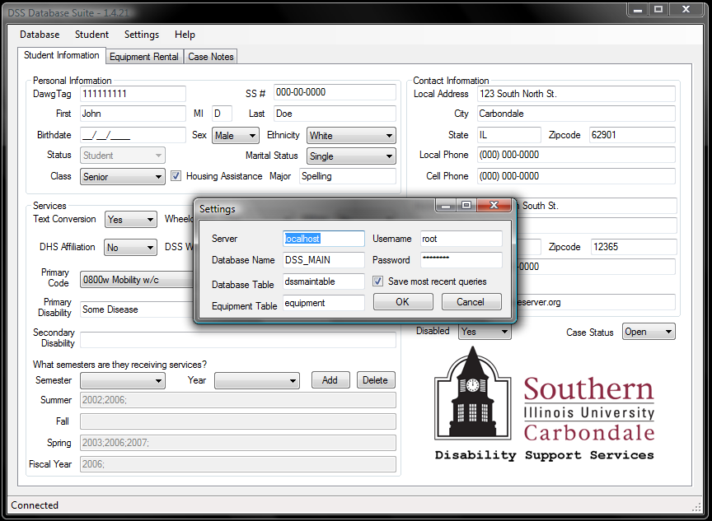
Settings

Slide 10
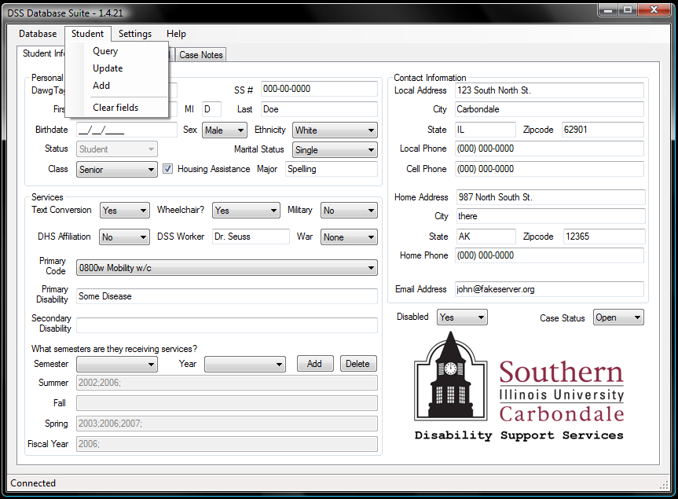
Add/Update Student Info

Slide 11
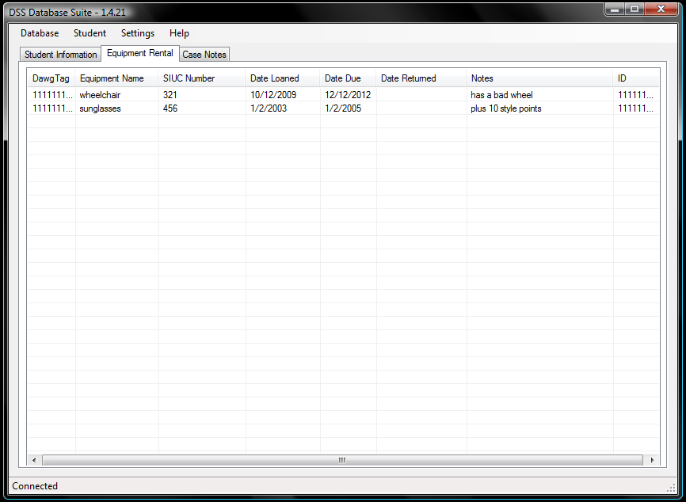
Equipment

Slide 12
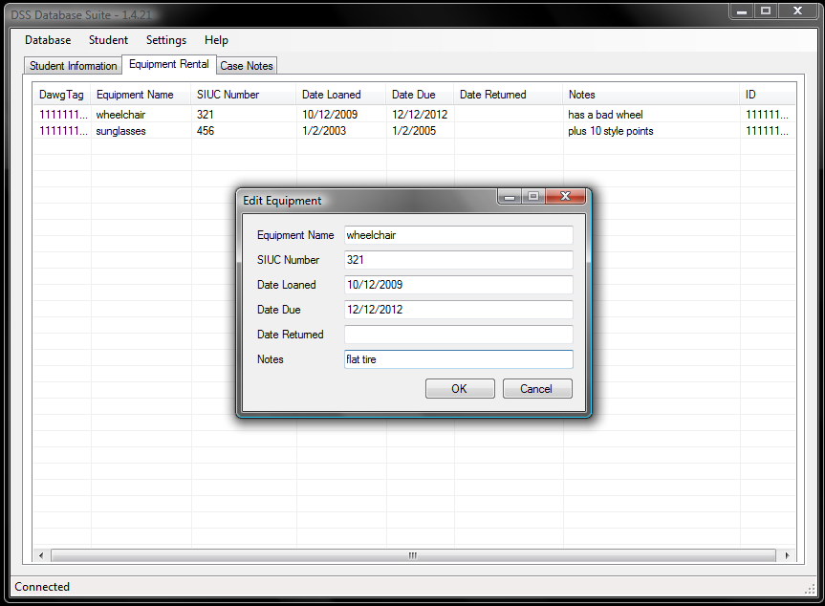
Add/Edit/Remove Equipment

Slide 13
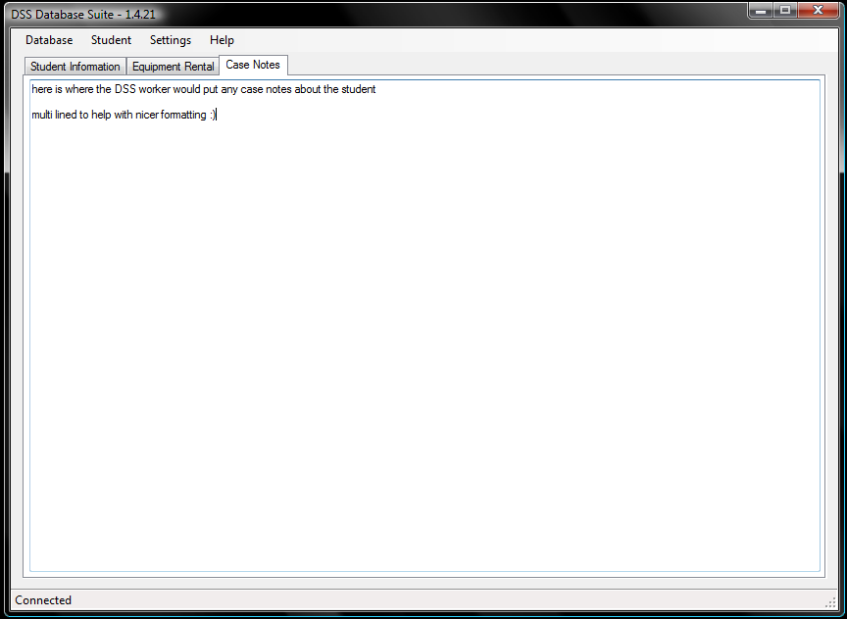
Case Notes

Slide 14
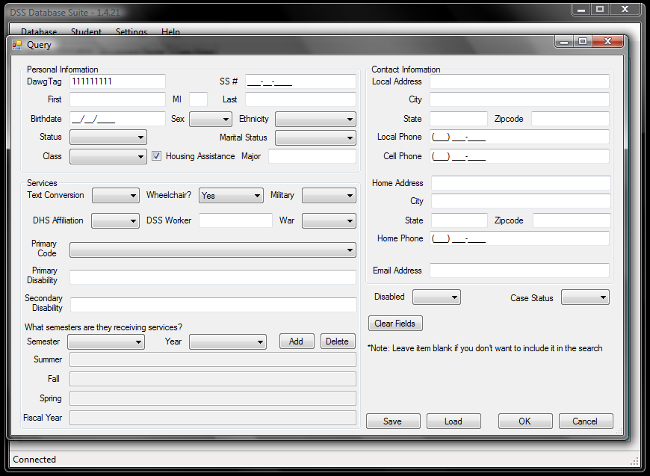
Query

Slide 15
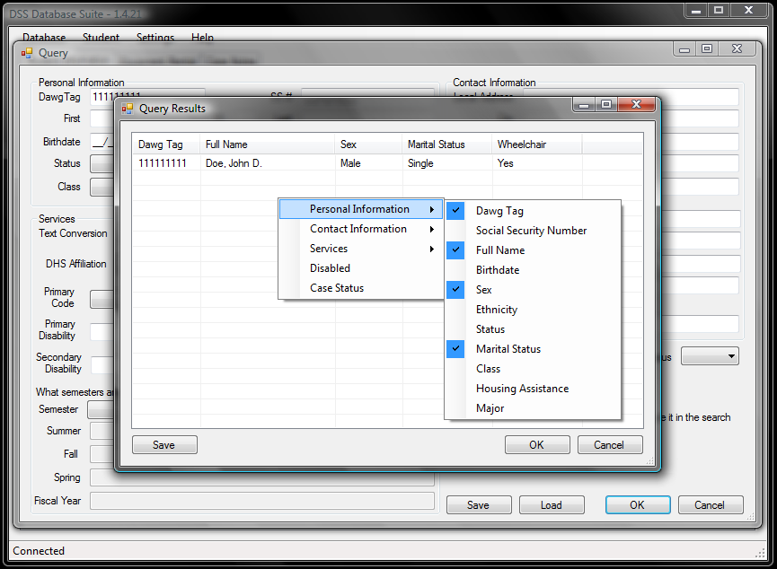
Query Results

Slide 16
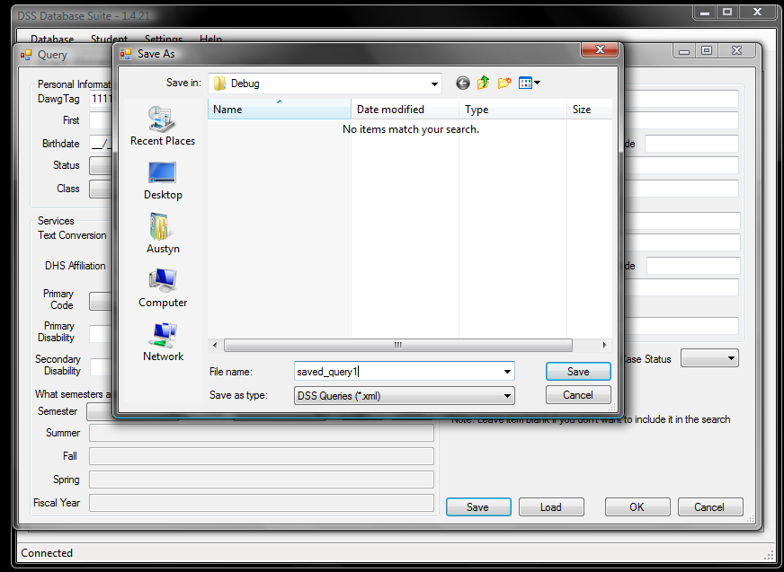
Save Query

Slide 17
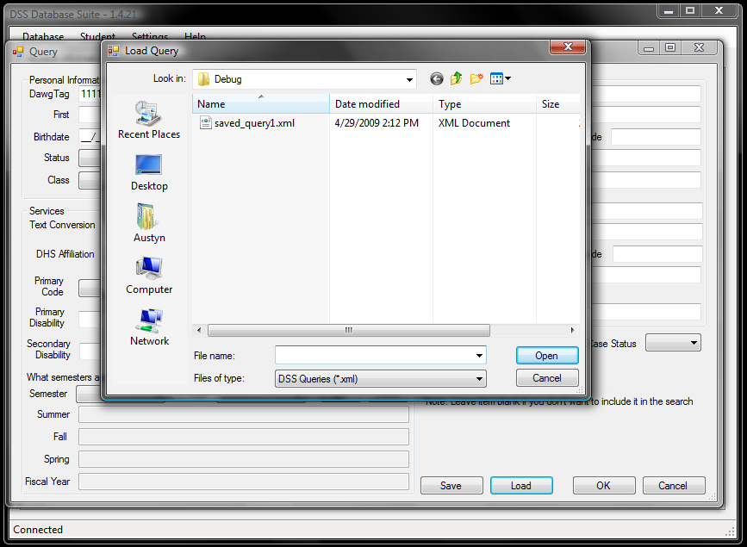
Load Query

Slide 18
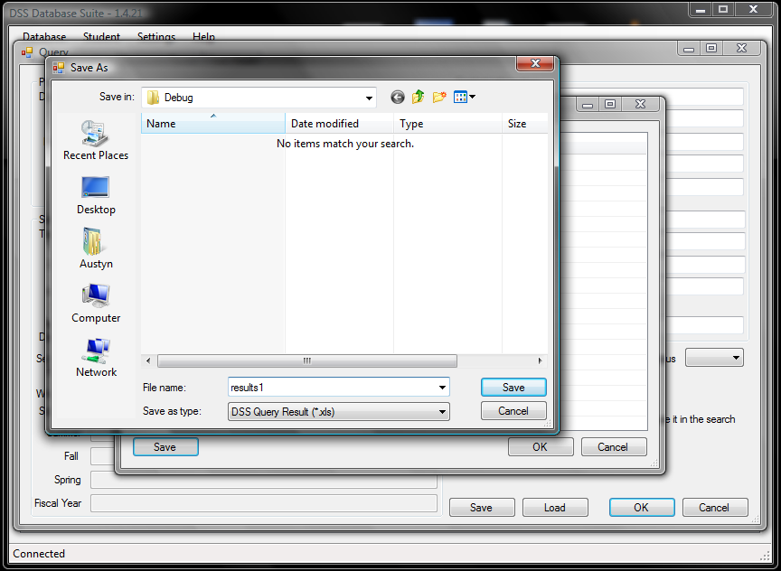
Save Query Results

Slide 19
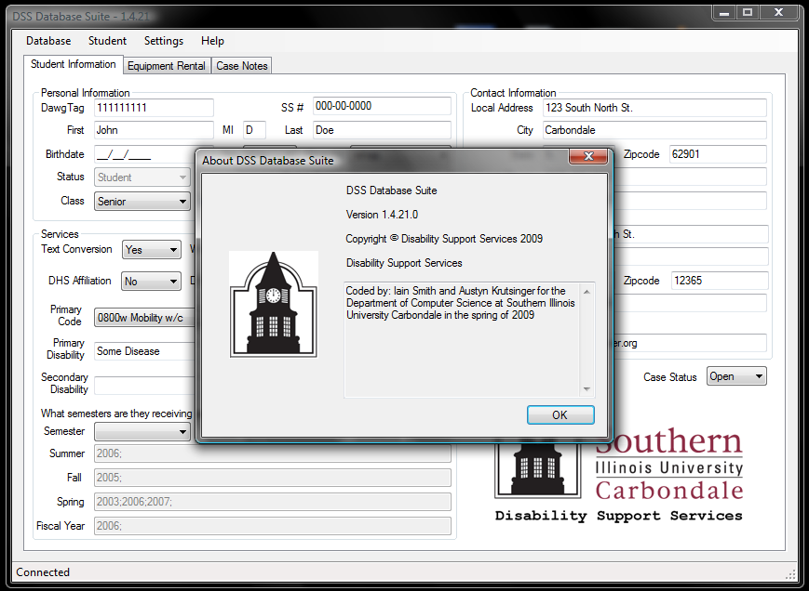
About

Slide 20
The old database to the new
Different architecture
Different formatting
Yet same information and a whole lot of records. 2,800+

Slide 21
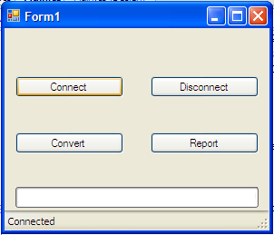
Conversion Program

Slide 22
I’m tired of explaining…
Do you have any questions?

